Slide 1






TWITCH BIG DATA ANALYTICS
Presented by:
Mustafa FarajAllah - 202310819

Slide 2
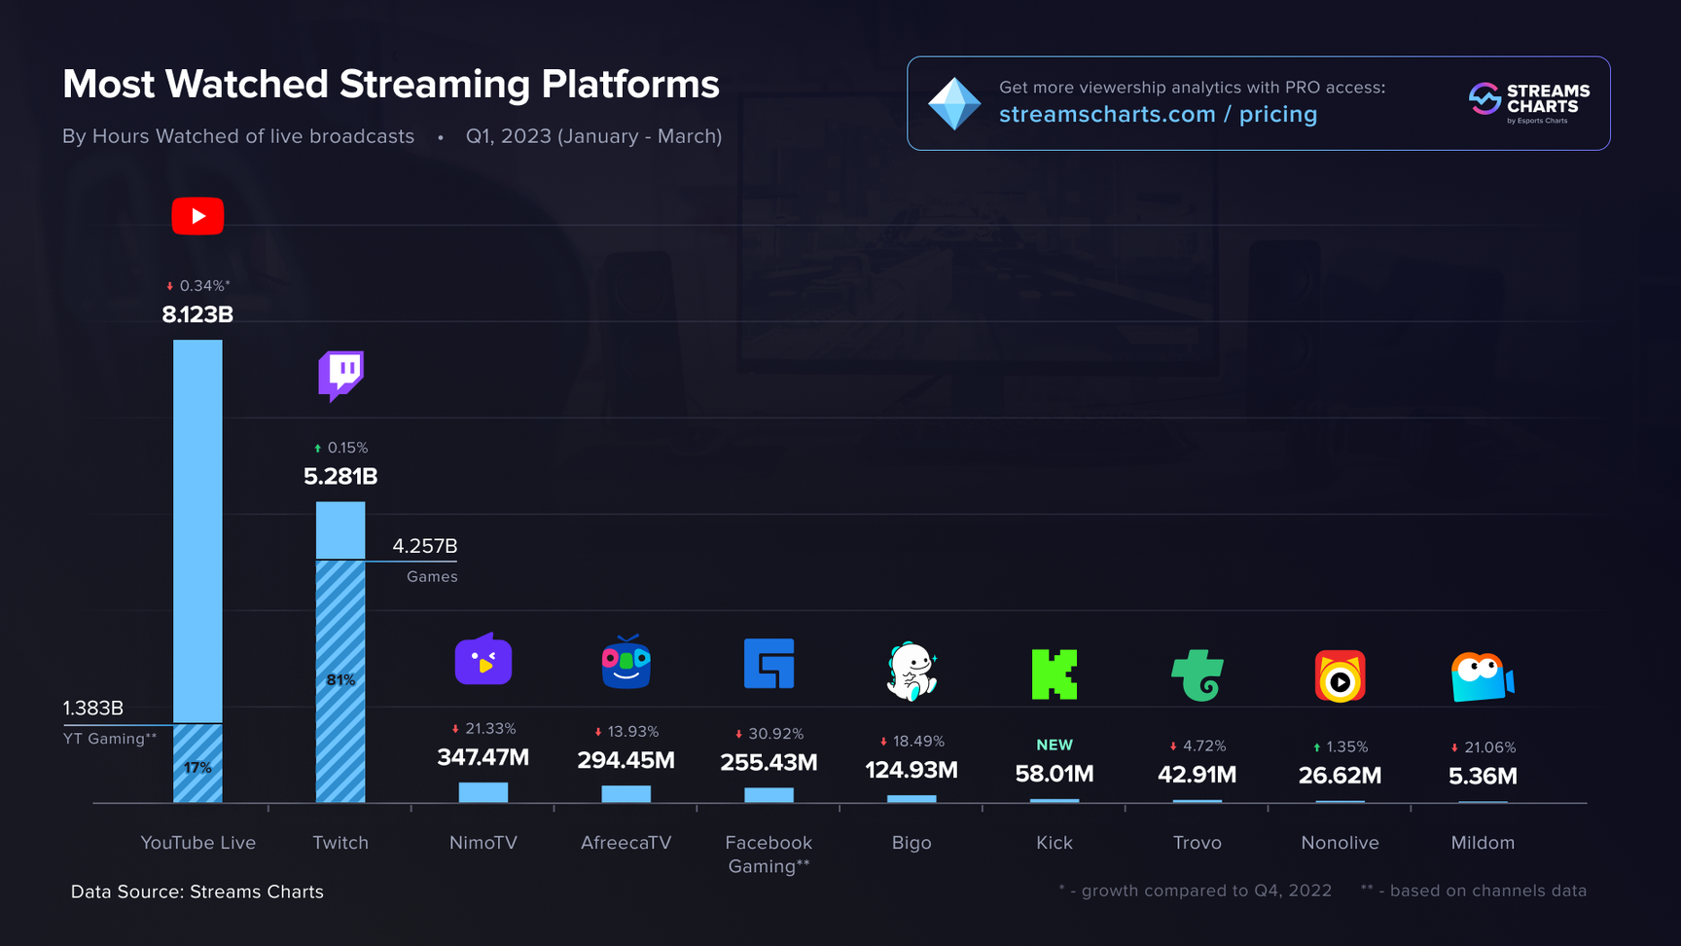
WHAT IS TWITCH?
Twitch is the leading video streaming platform, where users can watch live gameplay and interact with streamers. It allows content creators to broadcast games, esports events, and other live content to a global audience.

Slide 3


TWITCH API
Who can access the API?
How many requests?
1
2
Each user may only send a maximum of 800 requests to Twitch server PER minute.
Only authorized users who have 2FA enabled
Documentation?
3
Twitch provides extensive official documentation, covering APIs, authentication, and data access, enabling efficient data integration and development.

Slide 4
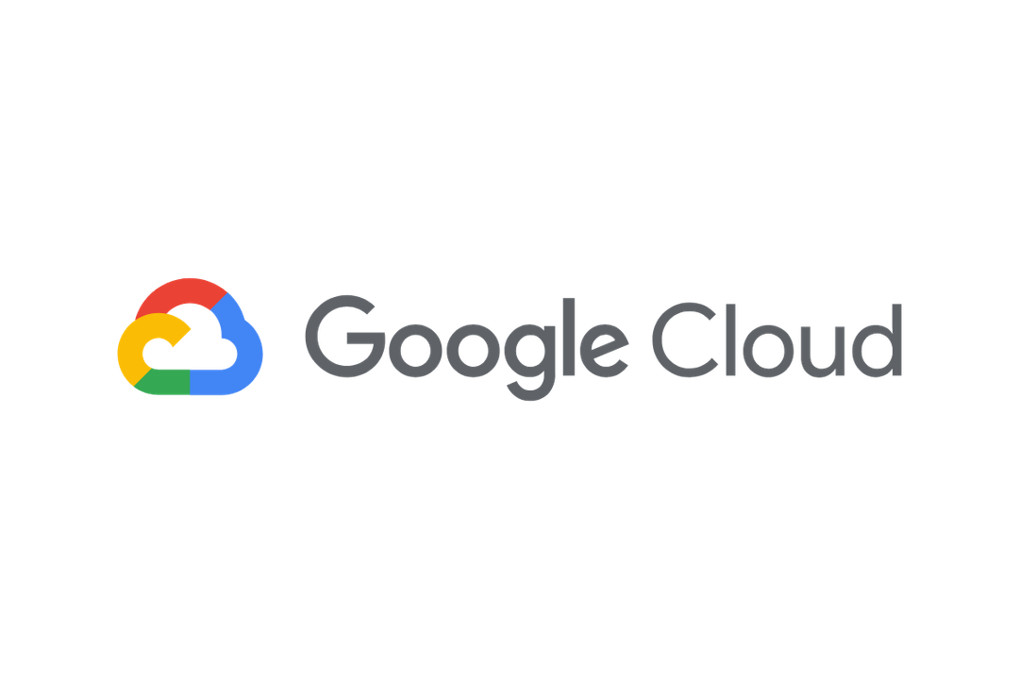
CLOUD PLATFORM CHOICE
We implemented our solution on the cloud, as it is the standard approach for handling big data in the modern era.
Google Cloud gave us a lot of advantages:
Support for real-time data streaming
Scalable data processing
Fault-tolerant infrastructure
Integration with analytics and ML tools

Slide 5
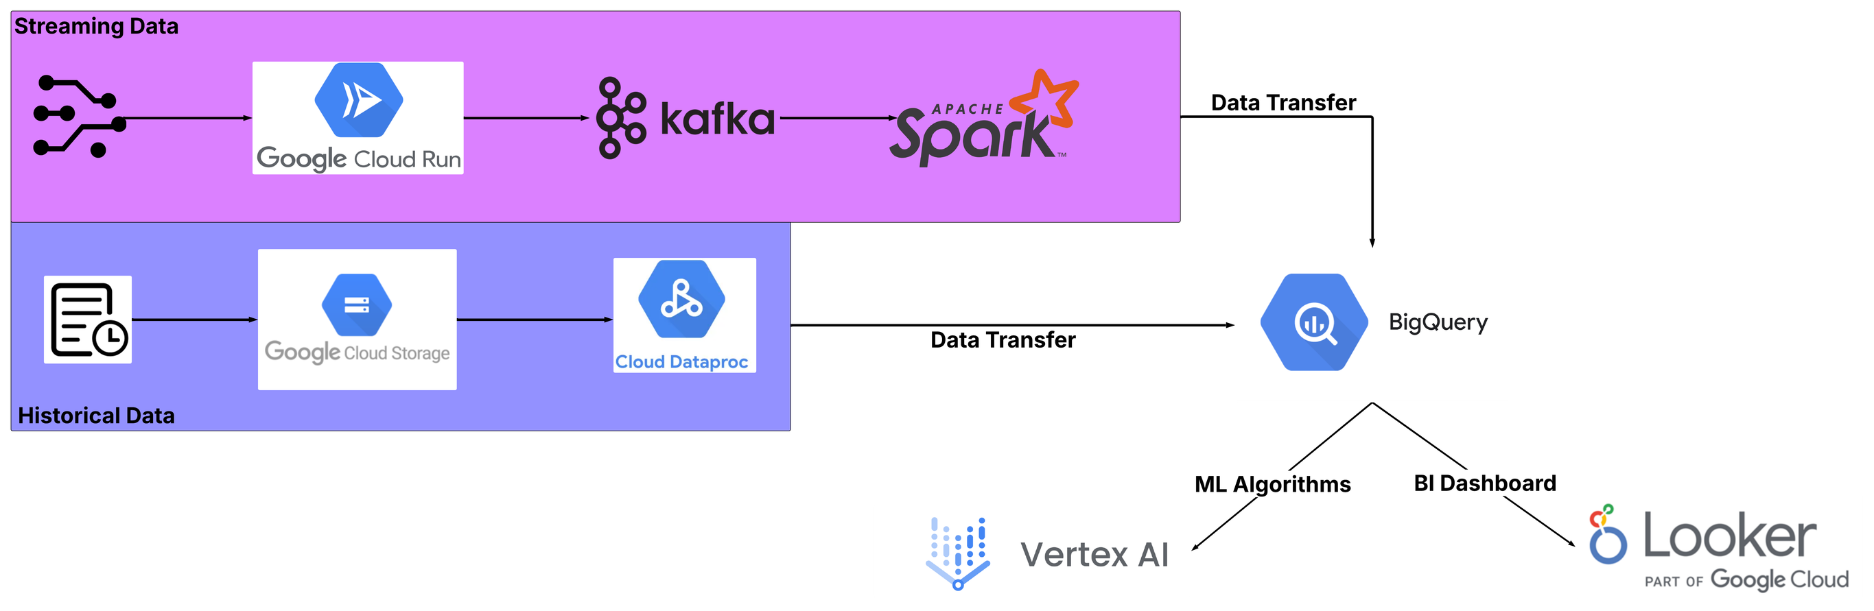
OUR BIG DATA ARCHITECTURE
Notes:
In the streaming part, Spark works on top of Cloud Dataproc.
In historical part, Cloud Dataproc is serverless.

Slide 6
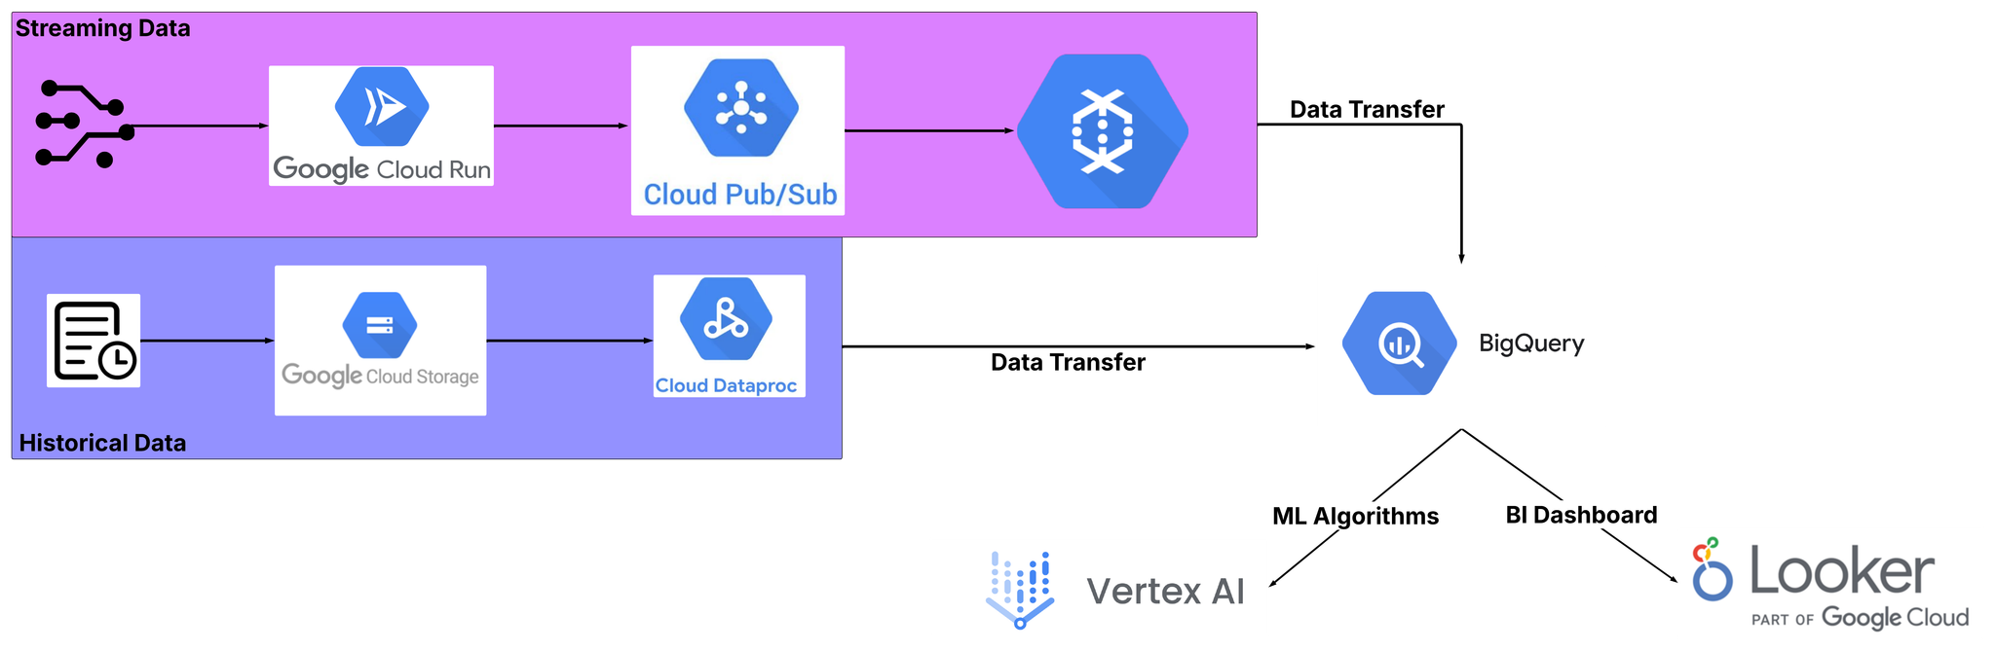
OUR BIG DATA ARCHITECTURE (NO.2)
Notes:
In the streaming part, we now utilize FULL cloud services, making the computation VERY FAST, compaired with before architecture.
In historical part, is the same as before

Slide 7
CLOUD

Slide 8
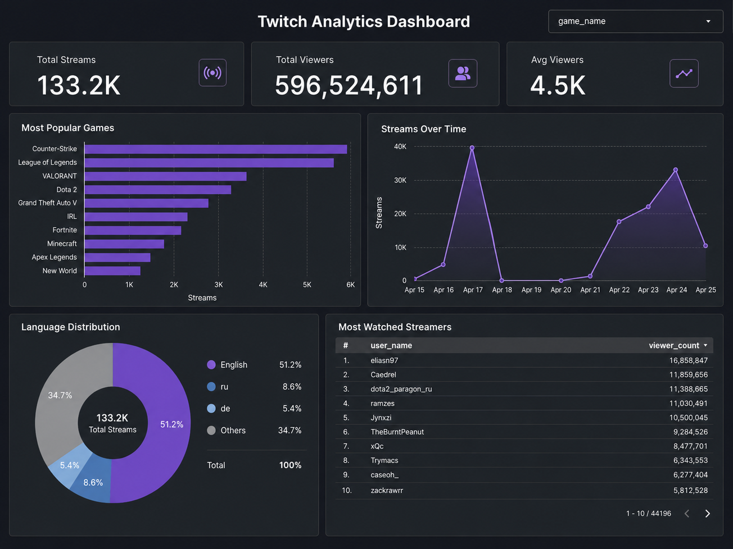

Slide 9
CHALLENGES WE FACED
API limits
Financial costs
1
2
Twitch only allowed us to have 800 requests per minute. No more, no less.
Implementing the project costs a well over $ 100.
Learning new tools
3
Learning cloud platforms from scratch, including understanding and integrating multiple services.

Slide 10

THANK YOU

